Slide 1
Lecture 24
Nick Rugai PhD

Slide 2
Analysis of Algorithm
The process of finding the computational complexity of algorithms.
Space (memory) and Time requirements
Prediction on performance of the algorithm to guide program design.

Slide 3
Analysis of Algorithm
One problem is that an algorithm might run differently from machine A to machine B.
Using a prototypical machine model might help.
Algorithm performance might be dictated by the data set: Use worst case scenario.

Slide 4
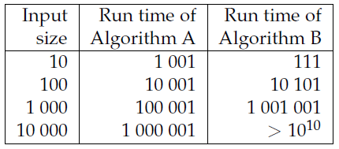
Analysis of Algorithm
The size of the problem and its complexity might not be a linear relationship.
If A behaves 100n + 1 and B n**2 + n + 1 steps:

Slide 5
Analysis of Algorithm
A behaves linearlly, B exponentially.
Below 100, B outperforms A. Above 100, A id preferred.
100 is called the crossover point.

Slide 6
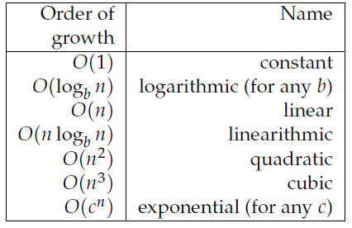
Analysis of Algorithm
100n, 2n, n+1 are examples of linear behavior.
N**2 is quadratic behavior.
Order of growth “Big-O”

Slide 7
Analysis of Algorithm
An algorithm run with a different language will have difference performance.
Usually, algorithms run on Python will be slower than a complied language like C/C++.

Slide 8
Analysis of Algorithm
In Python, division takes the longest, followed by multiplication, and addiction and subtraction last.
Indexing of list and dictionary is usually linear regardless of the size.
For loops are usually linear if the operation in the body is constant in time.

Slide 9
Analysis of Algorithm
If the body of the loop behaves O(n**a), the whole loop acts as O(n**(a+1)).
Strings and tuple are linear unless len or indexing is used, in which case is a constant.
Most library methods are linear.
Most dictionary operations are constant.

Slide 10
Analysis of Algorithm
Search algorithms are of dire importance for analysis.
The simplest search is linear which transverses the item in order: the worst case scenario is if the wanted item is the very last.
If the items on the object are in order, you can use a bisection search.

Slide 11
Analysis of Algorithm
A bisection search is like looking up a word in a dictionary: you know words are sorted in alphabetical order: You can start the search at any point.
A bisection search behaves as O(log n).
If a sequence has 1,000,000 items, bisection can find the specific item in 20 steps.

Slide 12
Analysis of Algorithm
Hashtables search are linear.
Dictionary use hashtables.

Slide 13
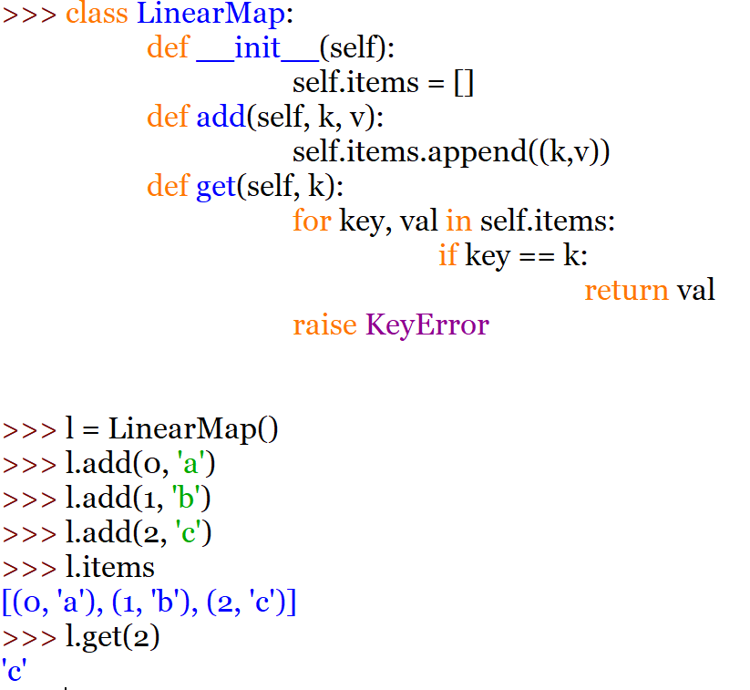
Analysis of Algorithm

Slide 14
Analysis of Algorithm
LinearMap, because of the standard for loop, is a linear search algorithm.

Slide 15
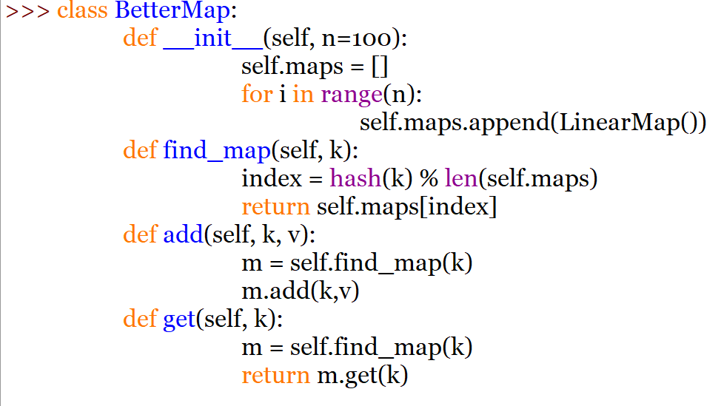
Analysis of Algorithm

Slide 16
Analysis of Algorithm
find_map uses the function hash which takes almost any Python object and returns an integer.
hash only works with hashtable keys.
BetterMap should be 100X faster than LinearMap.

Slide 17
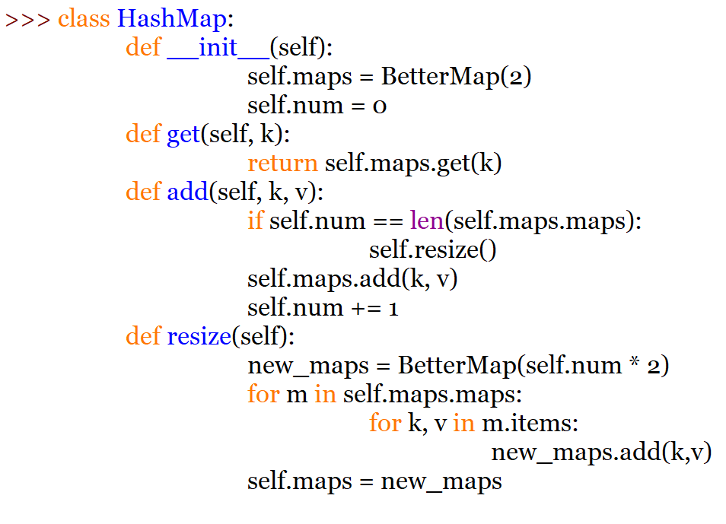
Analysis of Algorithm

Slide 18
Analysis of Algorithm
Hash() returns the hash value of any object that has one.
Integers are left intact.
Mutable objects are not hashable.
hash allows to keep track of objects using a simple integer.

Slide 19
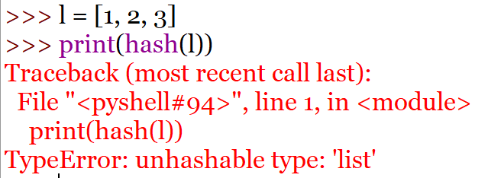
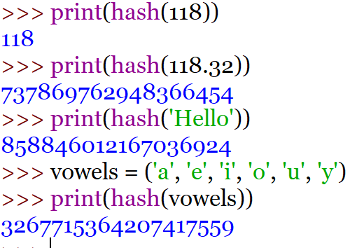
Analysis of Algorithm

